Slide 1

Our School’s Traditions
Primary school no 24
Social and Educational Society

Slide 2
Our school year
Our school year consists of four terms
Each term has a topic for example this part (the second one) is called „Big dreams of little feet”
After each term there are two final tests – one from English and one from Polish language, Nature Studies, Maths and History.
After each term we also get final grades

Slide 3
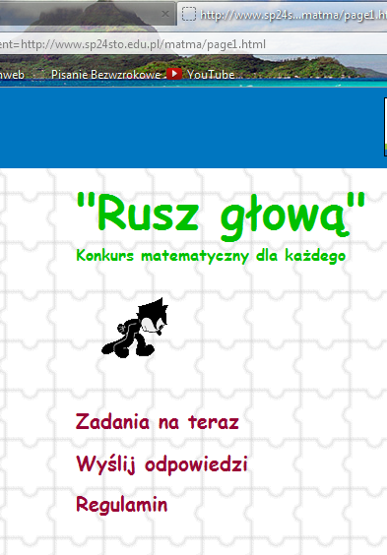
Math Competition
Every year our school also takes part in on-line Maths competition called „Move your head”
It consists of four parts
There are 6 exercises in each part – if you do 3 of them you get 1 point, but if you do all of them you get 6 points
At the end of school year there is an award for people who will get the biggest number of points

Slide 4
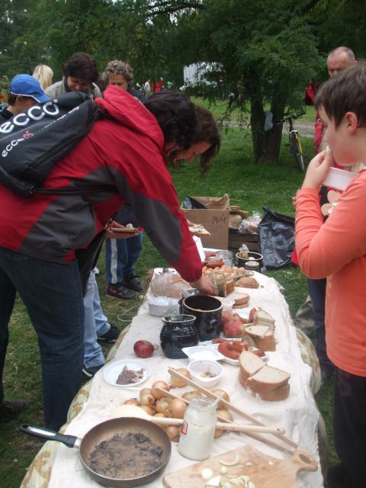
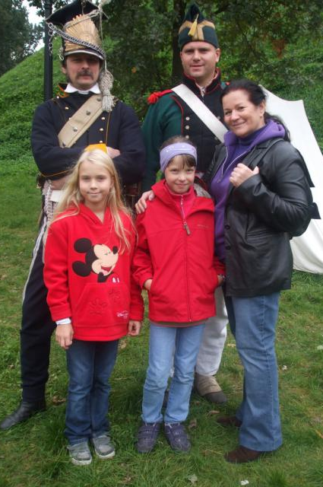
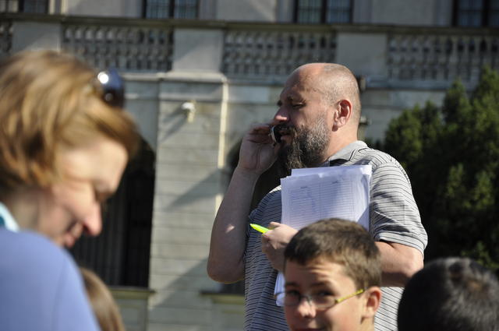
Family rally
It takes place twice a year – in Autumn and in Spring
The topic changes each year for example „Palaces of Warsaw” or „Warsaw on rails”
Each team consist of parents and children
Its participants must walk around Warsaw, visit some places where teachers and students prepare some exercise for them
They also must answer questions in a written form
All the answes to these questions can be found in places marked on a map

Slide 5
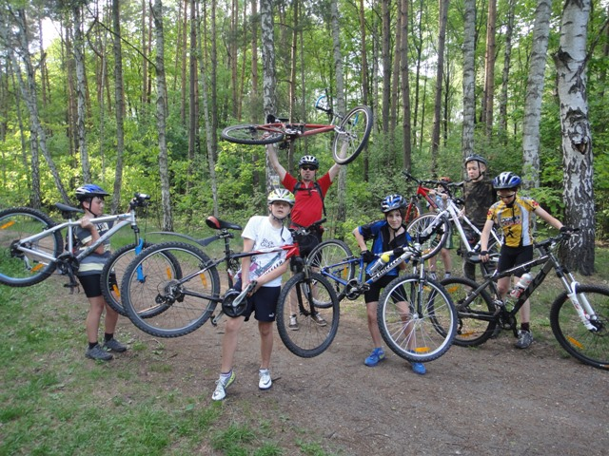
bike and motorbike cart
In Poland we need a license to ride a bike or a motorbike. That is why in September students from classes 4-6 can take an exam to get it
every year many students pass exam and we can go for many bike trips
We ride in national park or in the city, in some parks

Slide 6
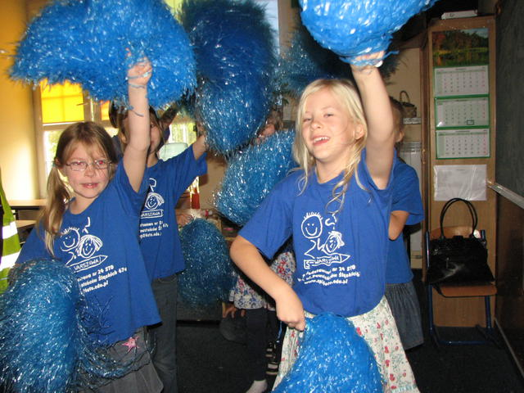
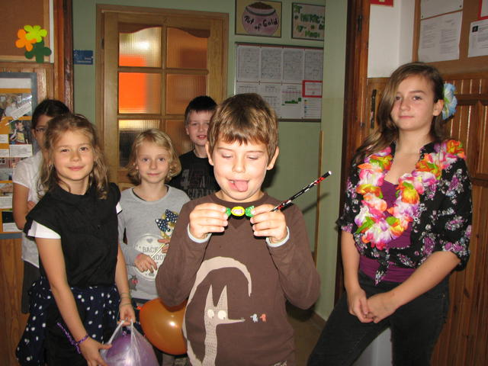
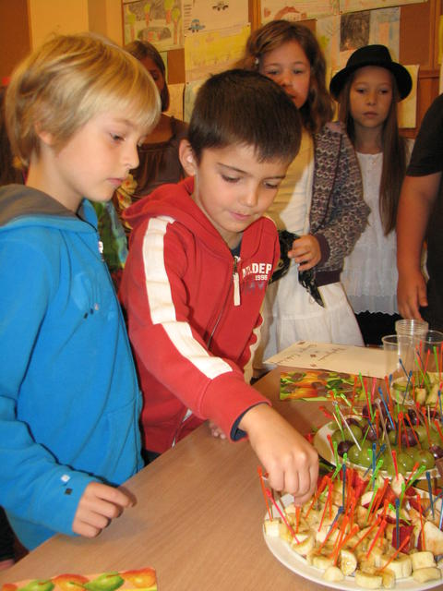
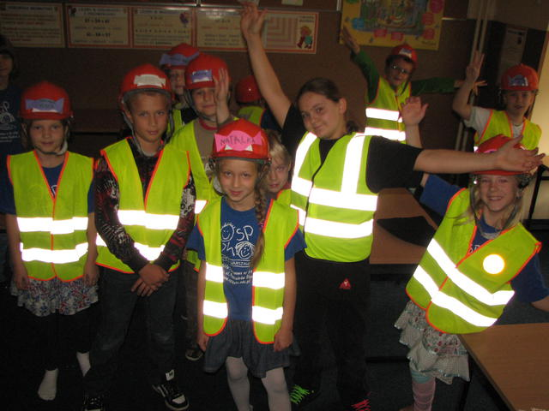
Initiation ceremonies
In September our school officially welcomes new students
All classes prepare wonderful suprises for new students. They can try many different sweets, visit a hairdresser, go back in time, visit chocolate factory, take part in a play etc.
At the end new students choose the best class and get their students IDS after they have eaten a slice of lemon and smile
That’s really great fun!

Slide 7
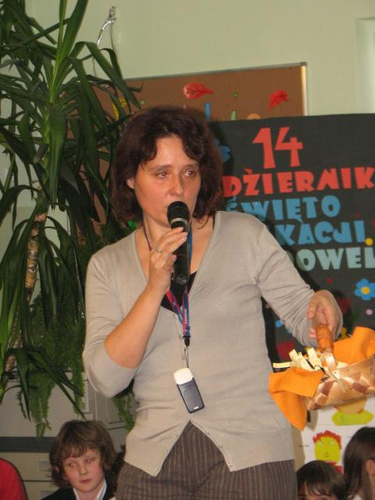
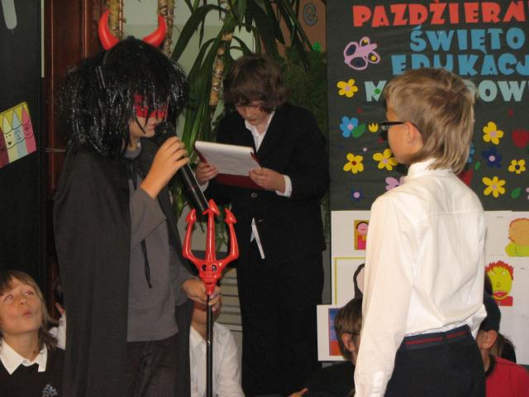
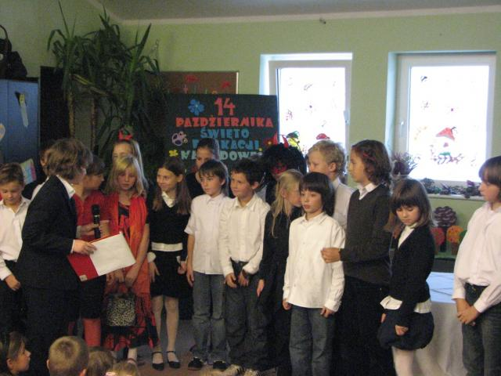
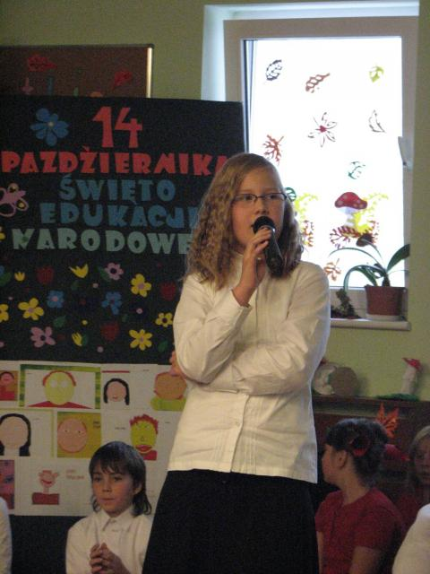
National Education day
On 14th of October Poland celebrates National Education Day, called also The Teacher’s Day
In our school it is prepared by 4th classes
They make a play for the whole school or only for teachers
They also give some presents for teachers, for example cookies or bookmarks
We often have a school assembly on this day

Slide 8
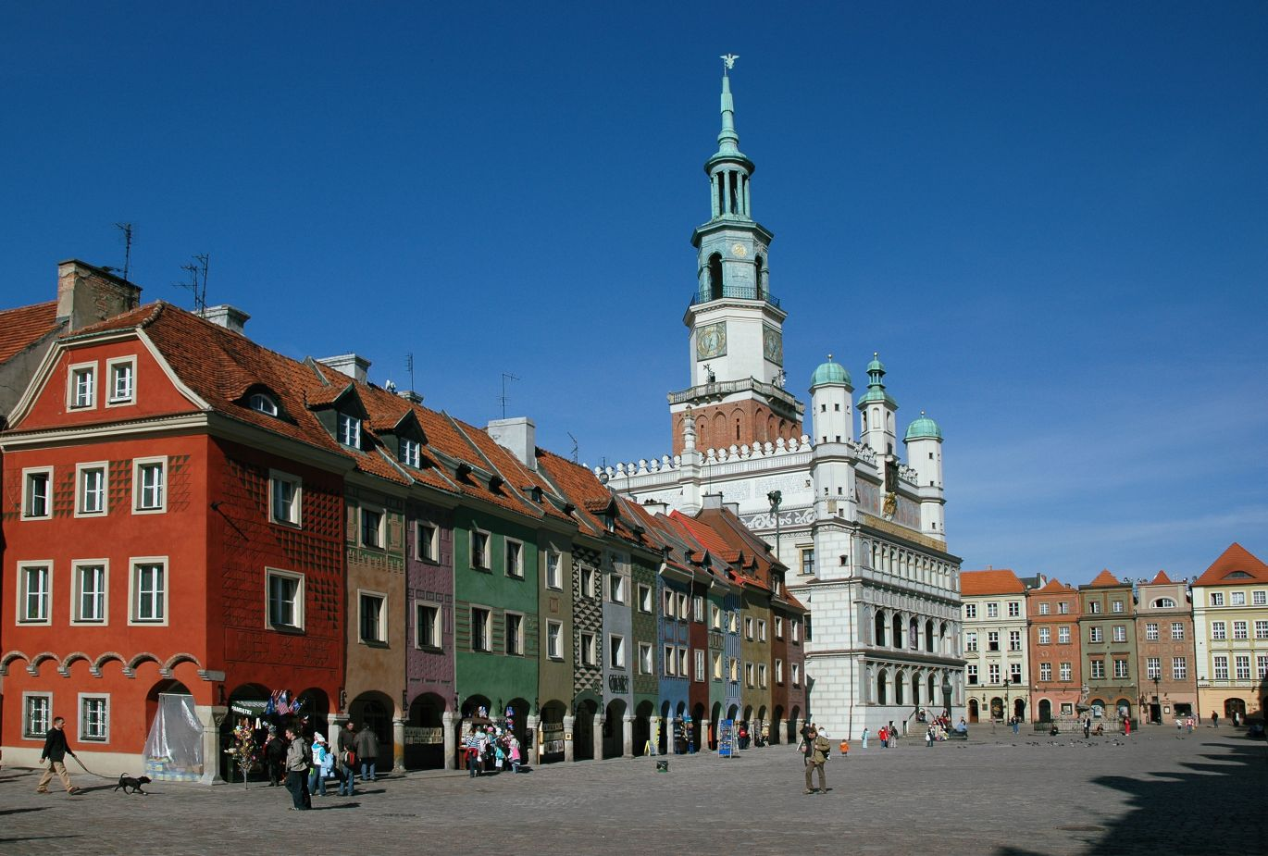
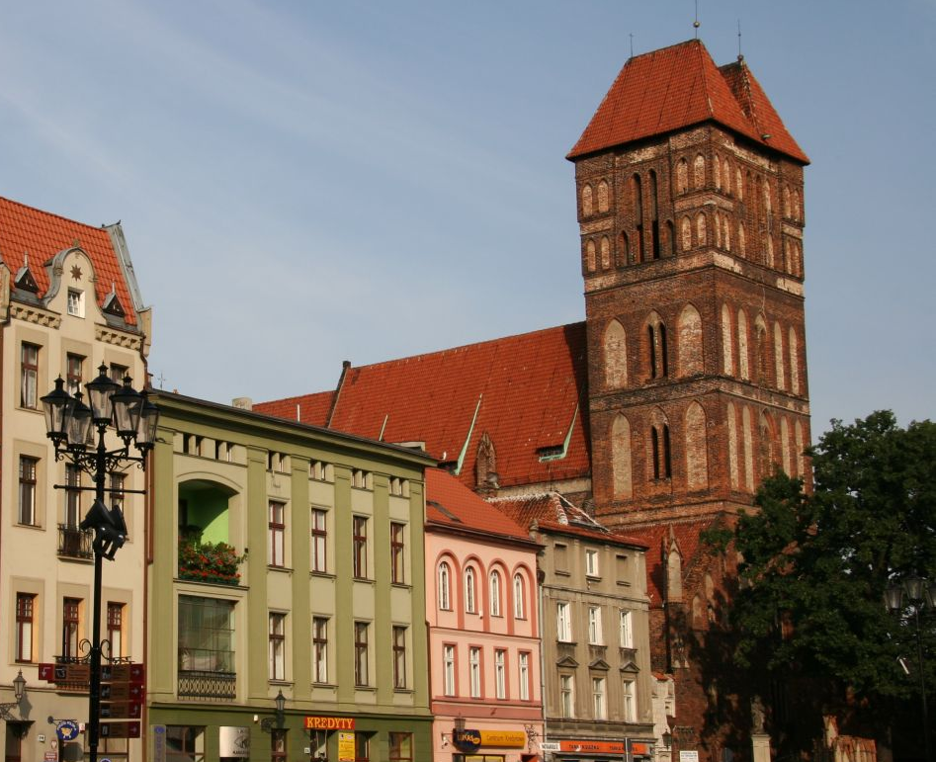
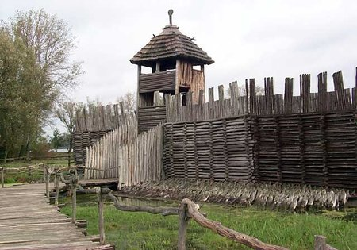
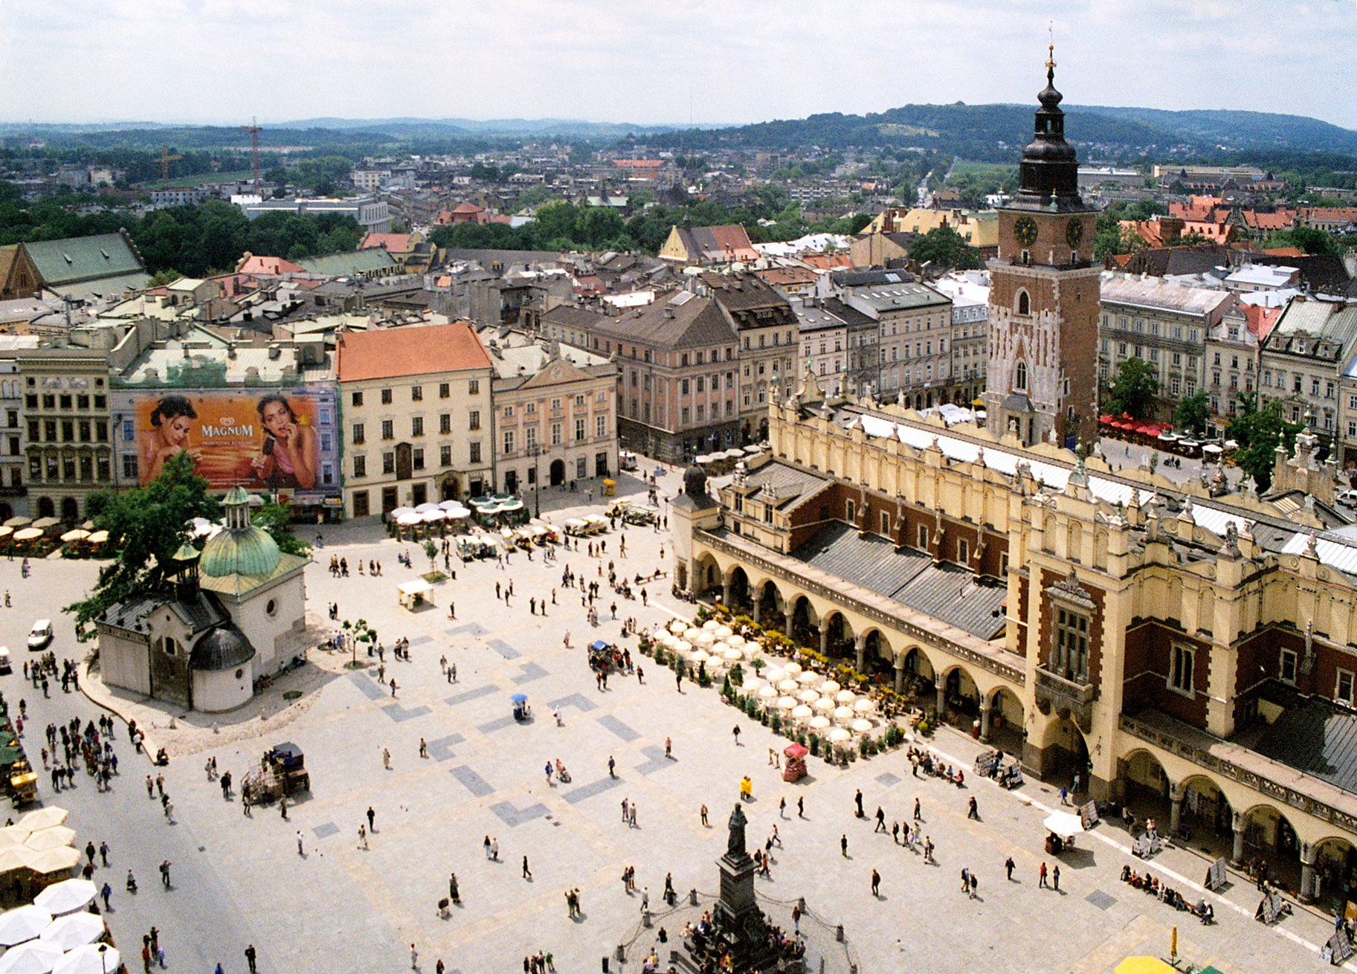
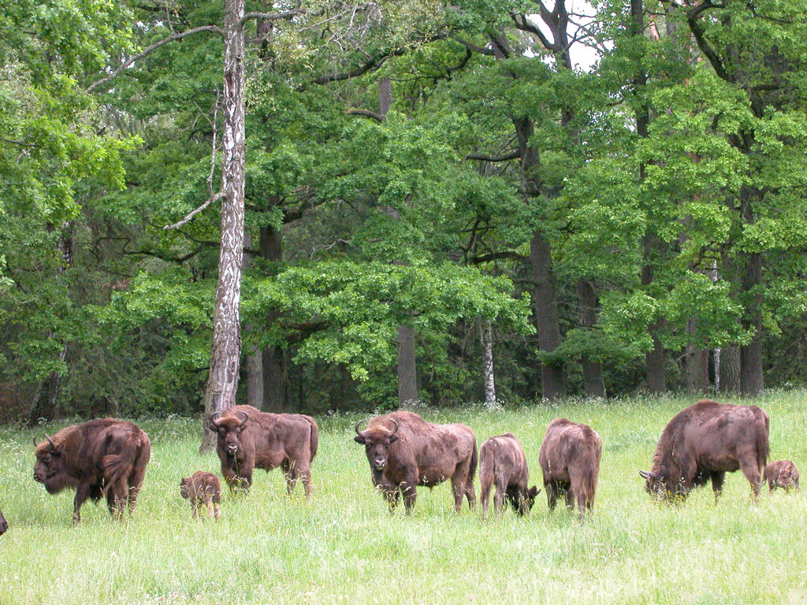
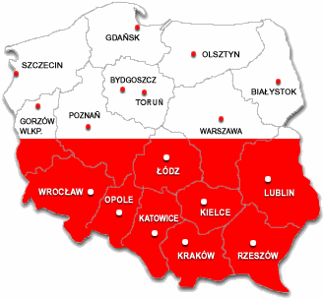
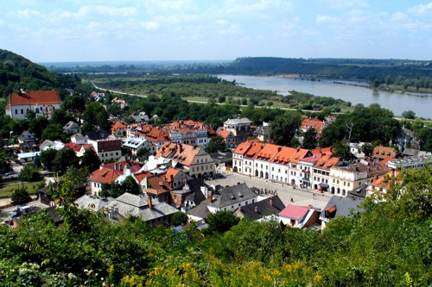
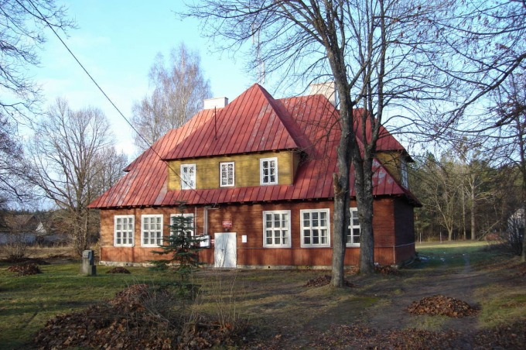
Trips around Poland
Every year in September or October all classes are going on some trip:
1st class students go to Bialowieza
2nd class students go to Kazimierz Dolny
3rd class students visit Torun and Biskupin
4th class students go to Rudawka
5th class students go to Poznan
6th class students visit Cracow
On these trips we visit palaces, castles, churches, museums etc. It’s a great experience for us

Slide 9
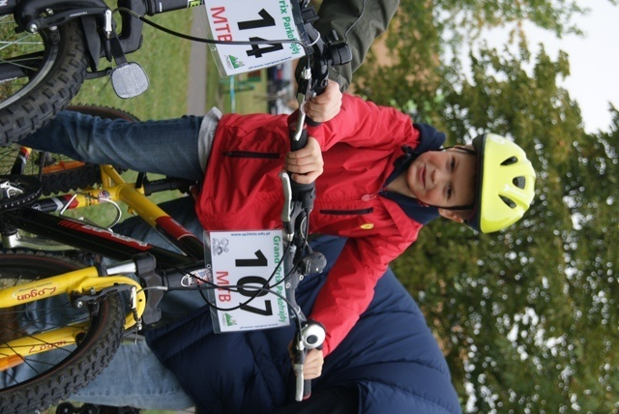
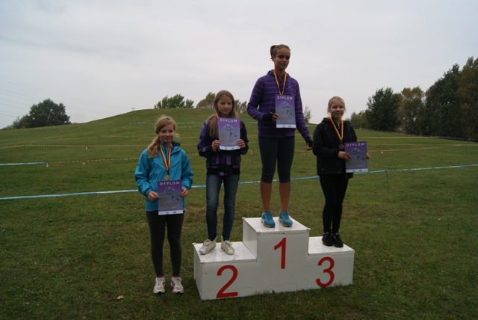
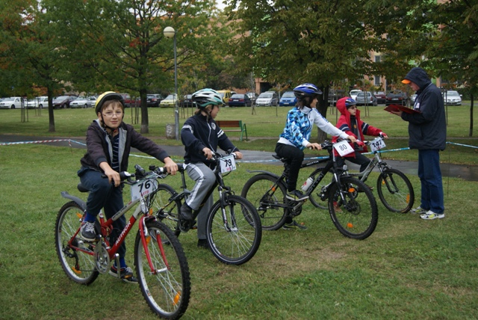
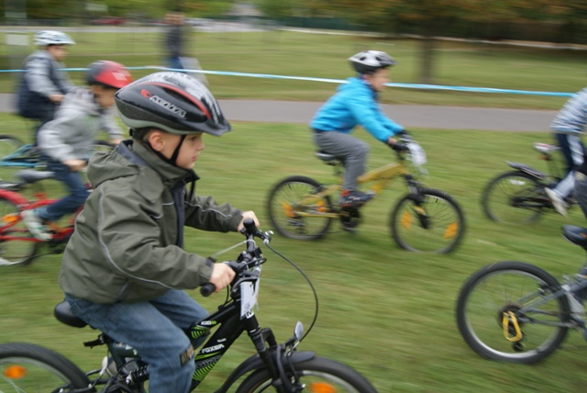
Parkofrajda Grand Prix of
It is a bike race around a hill, which is near our school. People from 5 to 99 can take part in it.
It takes place twice a year
There are different age categories so there are about 10 categories
The winner of each category get a medal or a diploma

Slide 10
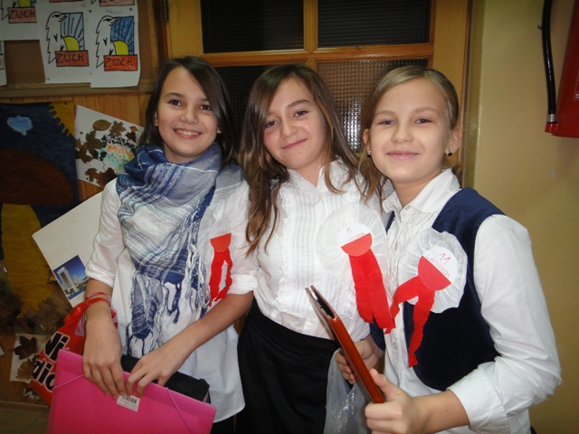
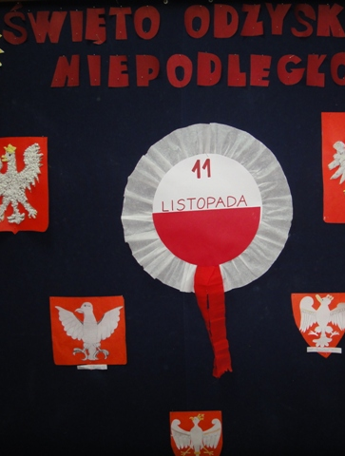
Independence day
Every year students from 6 classes prepares Independence Day which is on 11th of November
Independence Day is in Poland very important day because it’s an anniversary of independence after 123 year of slavery which took place in XVIII-th and XIX-th century
For example in this year we were going around all classes and telling them about that day

Slide 11
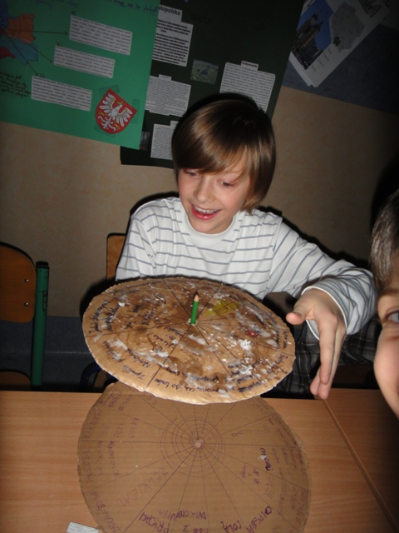
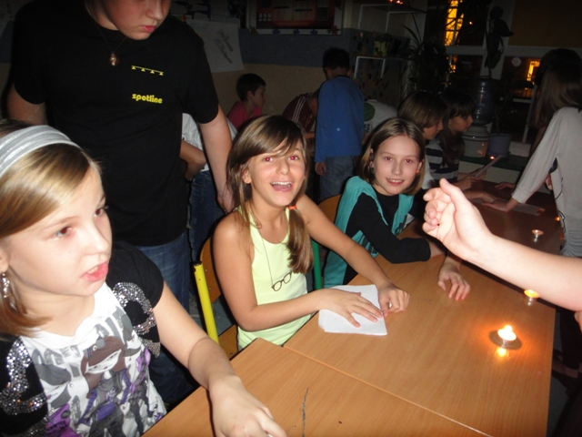
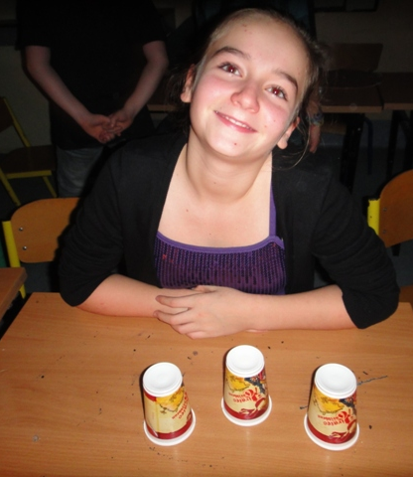
St. Andrew Disco
We foretell many things to each other on it
Every year near 30th of November in our school is St. Andrew Disco
If you come to this party you will know name of your wife/husband, your job, what mark of car you will have, what dress you will have on your wedding etc.

Slide 12
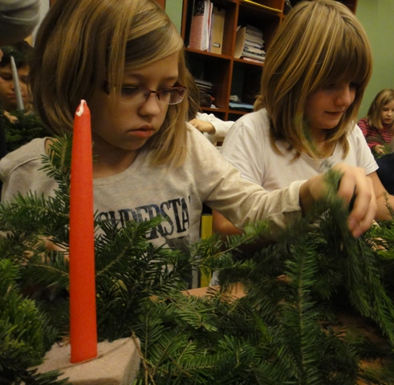
Class’ Christmas Eve
Last day at school before Christmas break all classes from our school have their own Christmas dinner
Students bring to school cakes, salads and other dishes
Then we are sitting near decorated table and eat together

Slide 13
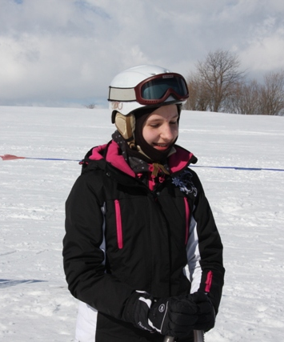
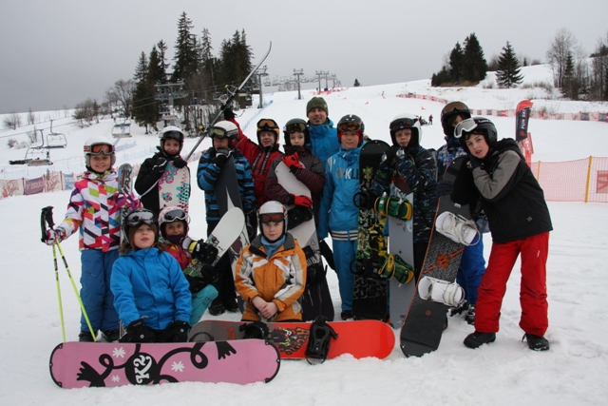
White School
Every year in December or January volunteers go on the White School
White School takes place in Bialka Tatrzanska, which is in the mountains
Students are learning how to ski, snowboard, etc.
It takes one week
Then in March there is a competition from winter school

Slide 14
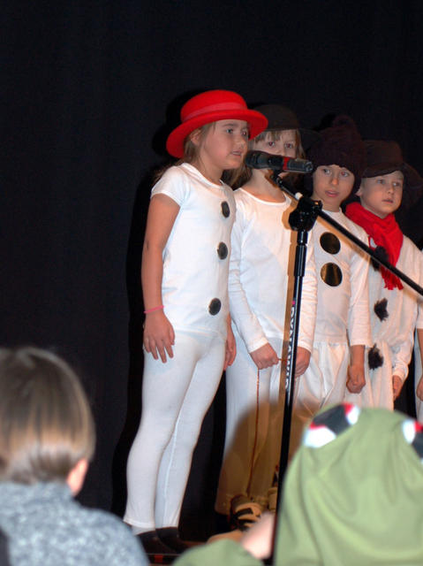
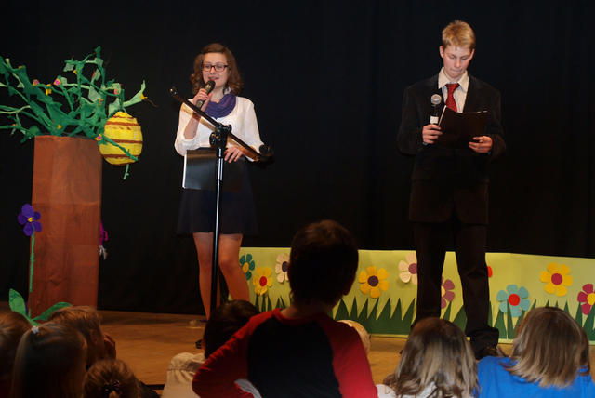
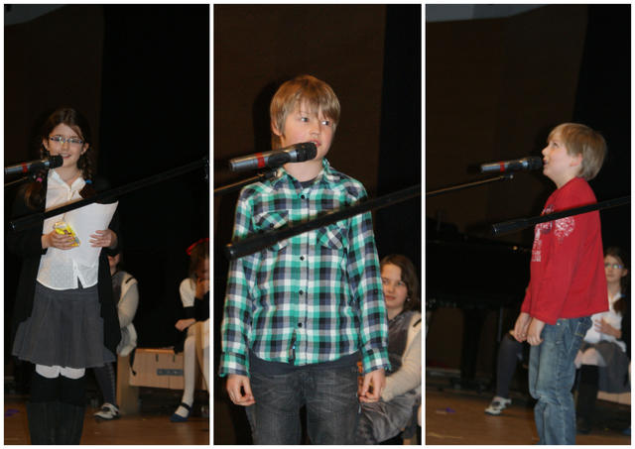
New Year’s Concert
New Year’s concert is very important day at school
All classes 1-3 prepare some plays or they sing some songs and tell some poems
There are people who sing alone
Our students also tell about our school, about new projects and other events etc.

Slide 15
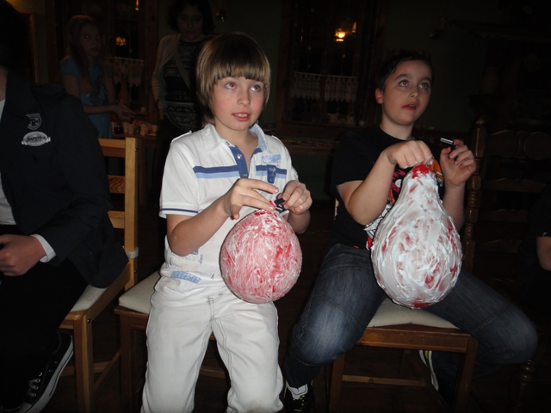
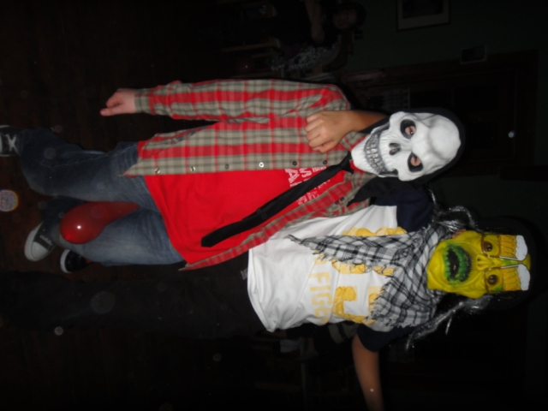
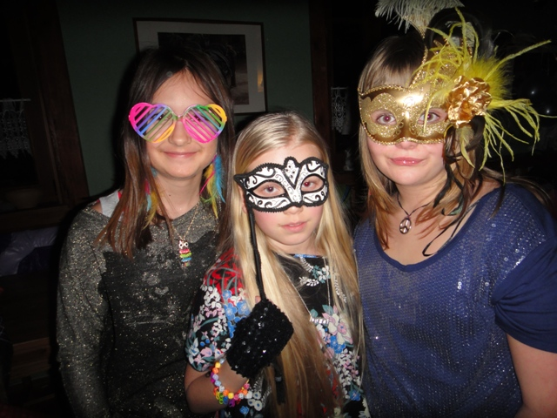
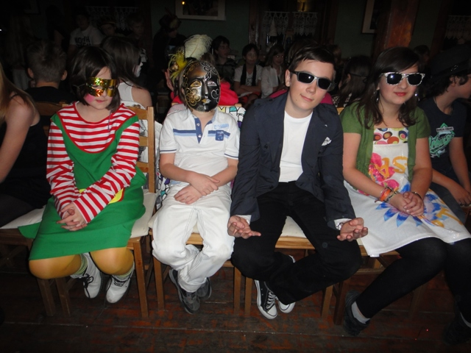
Carnival Bal
During carnival volunteers from classes 4 – 6 leave their houses for one night because they go for a party!
All balls have got the same topic, for example „Stars” or „Daub”
It takes place in Stara Dabrowa
We leave school and go there by coach. We are there at about 6 pm, we eat supper, and then dance until morning
During the party we’ve got many games
The next day we come back Warsaw

Slide 16
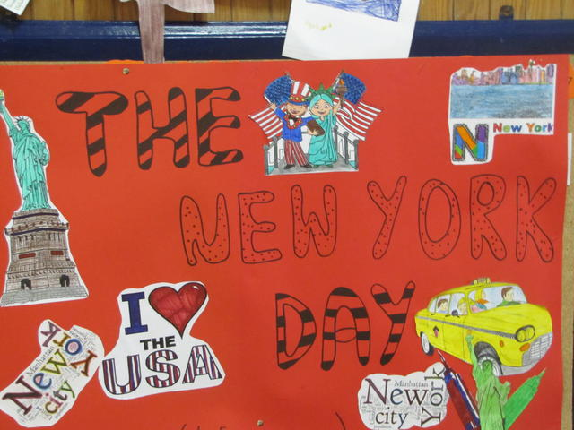
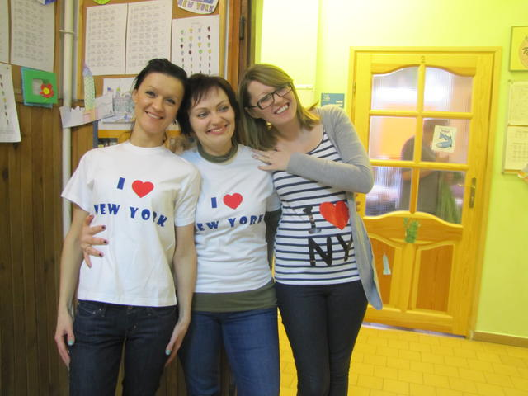
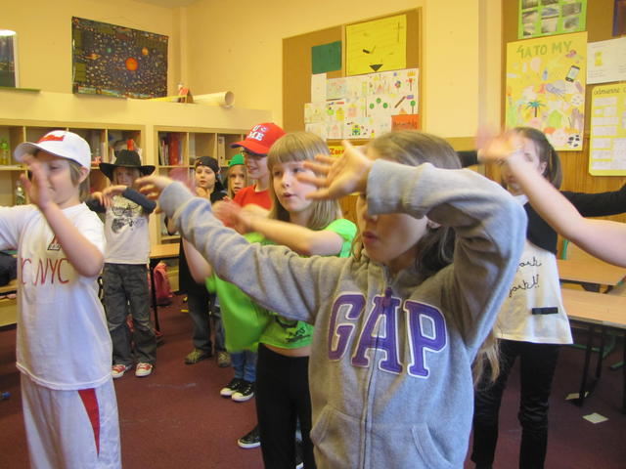
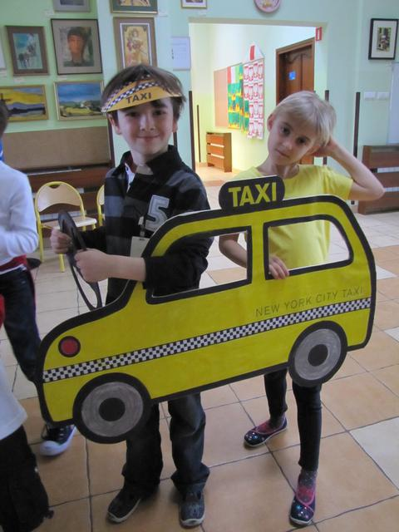
English- Language day
On the 21st of March we’ve got very special day in our school
Students from class 6 and teachers prepare English – language day for all school
On this day each class must go around points in school on which they must to do some exercise and collect as many points as it can.At these points classes must dance, sing, fill the gaps in the text etc.
We’ve already had American, English, Scott and Africa day.
Class, which win get some prize

Slide 17
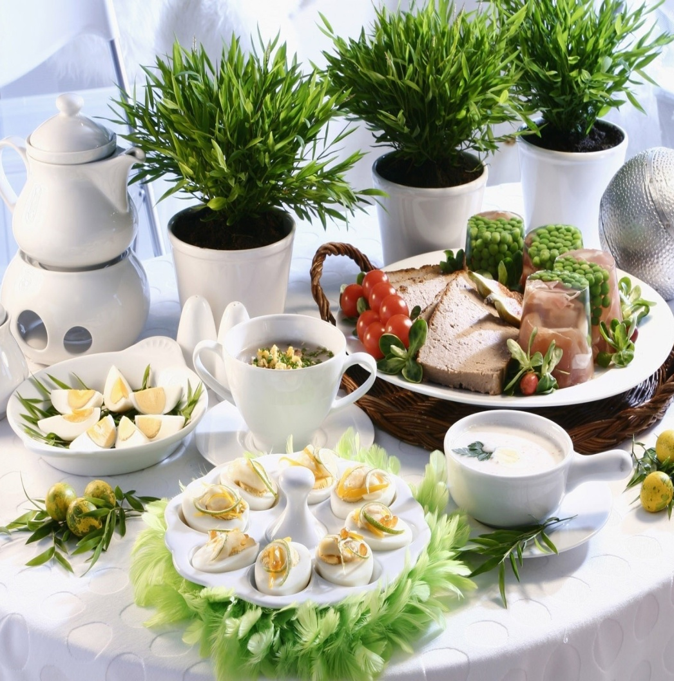
Class’ Easter breakfast
As before Christmas on the last day in school before Easter break all class have got their Easter Breakfast
All people from class prepare something to eat or to decorate classroom
Then we eat together, egg share and nicely spent time

Slide 18
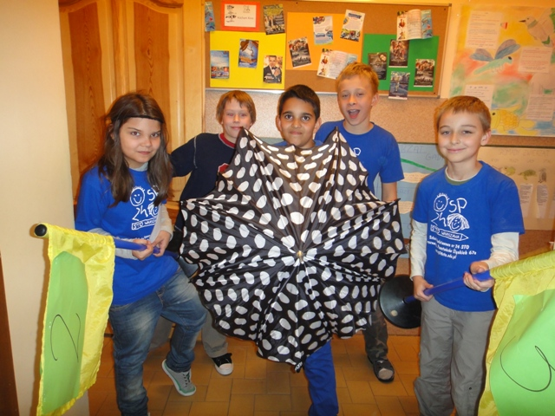
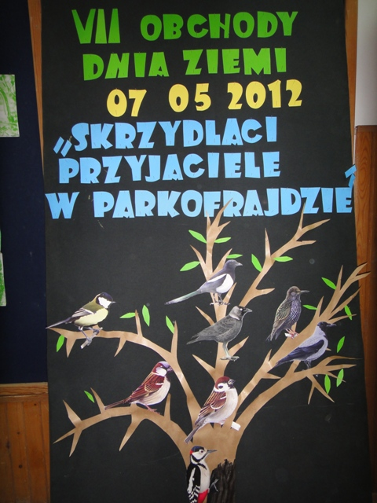
Earth day
Near our school, in the park called Parkofrajda, every year in April or May is the Earth Day. It’s consists of game for class 0-3 and a picnic
During the game students must go around some stations and collect points. They can get points for answer questions, do some tasks etc.
On the picnic you can go to stations on which you can get prizes for answering questions. You can also climb on the climbing wall, play team games, ride on fire engine etc.

Slide 19
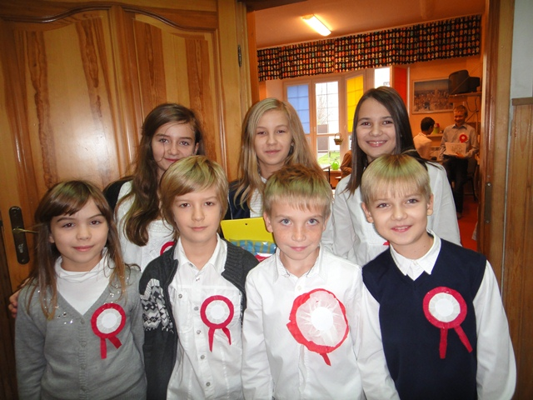
Constitution day on 3rd May
Constitution Day on 3rd May is second very important day in Poland which we celebrate
Students from class 5 prepare this day
As on Independence Day they go to some classrooms and talking about the history of this day

Slide 20
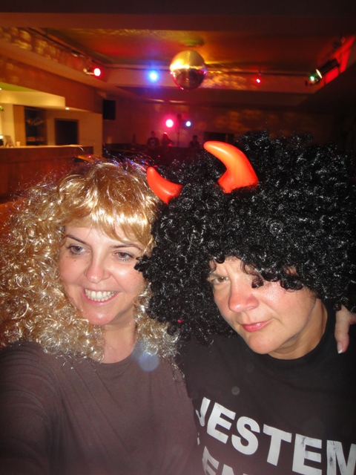
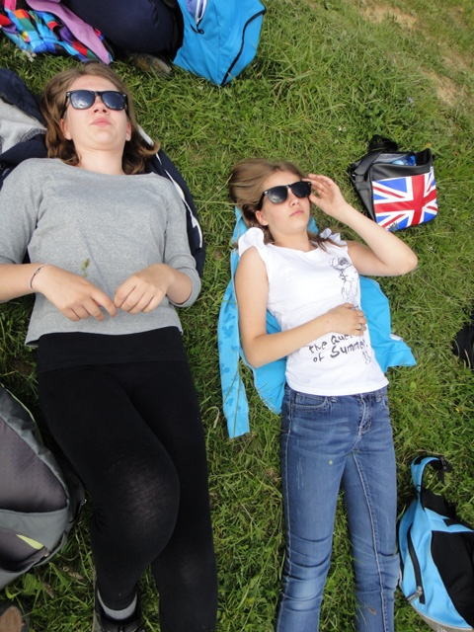






Green School
In May or June students from all school are living their houses for more than 5 days
We are going on the trips to some places in Poland
During green school we have many trips, games, discos, bonfires etc.
At the last day at green school all school take part in game prepared by teachers. Teams are make of students from all classes 1-6. They must collect points and having great fun

Slide 21




School’s day
The last big event in our school is the School’s Day
It takes part in June and always has some topic for example: „Japan” or „Once a folkloric”
During this day students with their families can see how people live in some parts of the world. For example during day called „Once a folkloric” you could met food, hobbies, work, customs, dances and dress of people from the countryside. It was funny and interesting.

Slide 22
Thanks for your attention
Julianna Piskorz 6b

